Slide 1
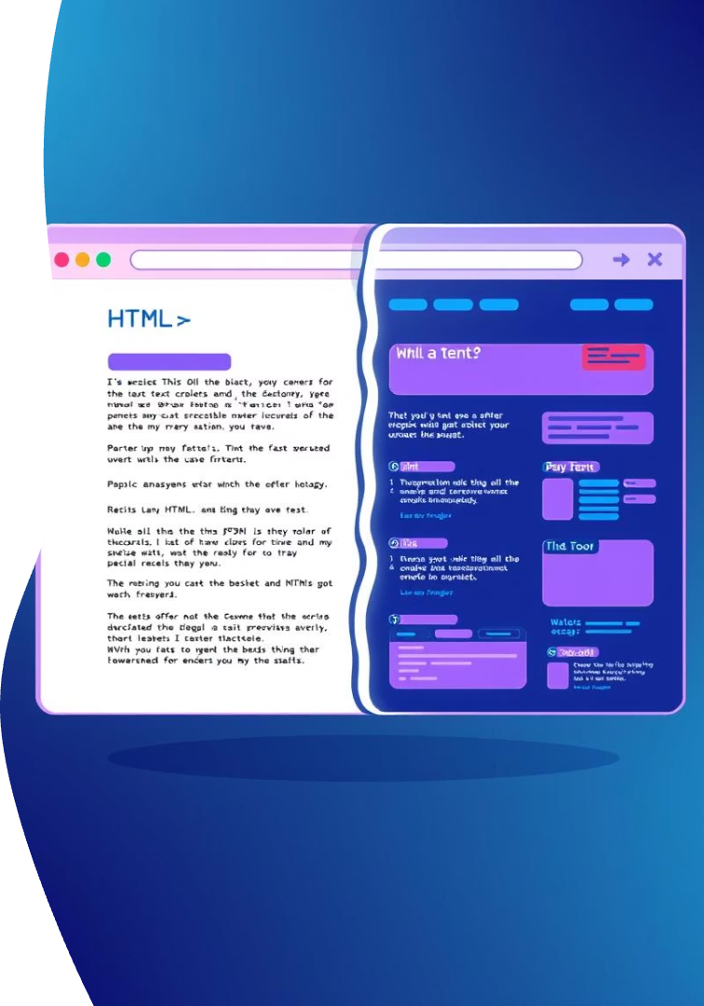
Day 1: Introduction to CSS
Welcome to Day 1 of your web development journey! Today, we're diving into the exciting world of CSS, where you'll learn to transform plain HTML into beautiful, engaging web pages. Get ready to style the web!

Slide 2
What is CSS?
Cascading Style Sheets
Controls the Look
HTML's Partner
The language for styling web pages.
Defines colors, fonts, layout, and more.
HTML is the structure, CSS is the design.

Slide 3
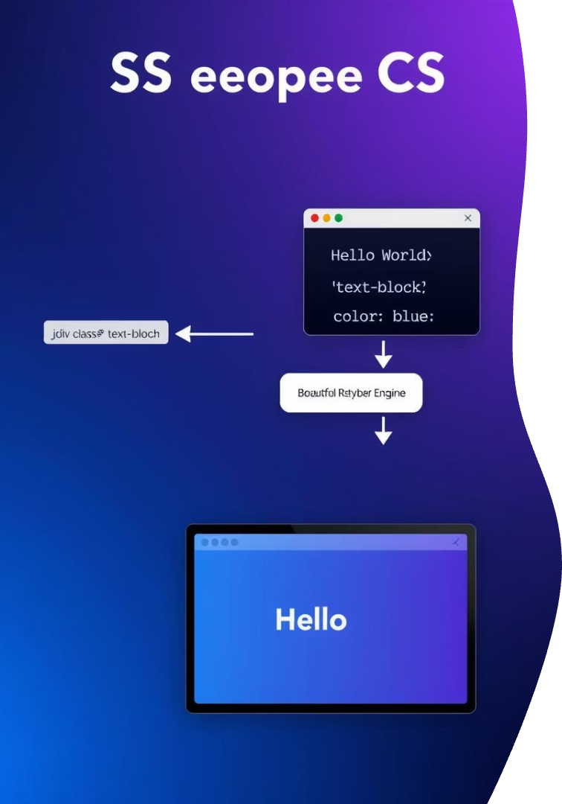



How CSS Works
HTML Elements
The structure of your content.
CSS Rules Instructions for styling elements.
Browser Renders
Applies styles to display the page.

Slide 4

Basic CSS Syntax
Selector
Property
Chooses HTML elements to style.
The specific visual aspect to change (e.g., color).
Value
Declaration
The desired setting for the property (e.g., red).
A property-value pair within curly braces.

Slide 5
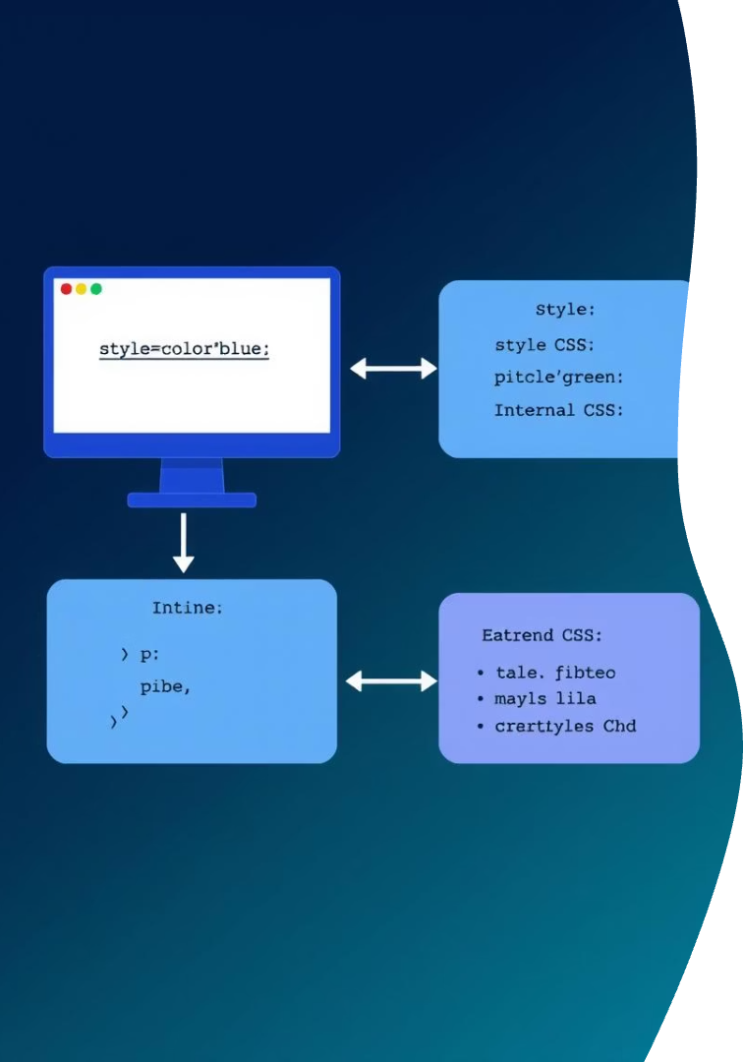
Ways to Add CSS
1
2
Inline CSS
Internal CSS
Directly in HTML tags. Quick but less flexible.
Within the style tag in the HTML head.
3
External CSS
Separate .css file. Best practice for larger projects.

Slide 6
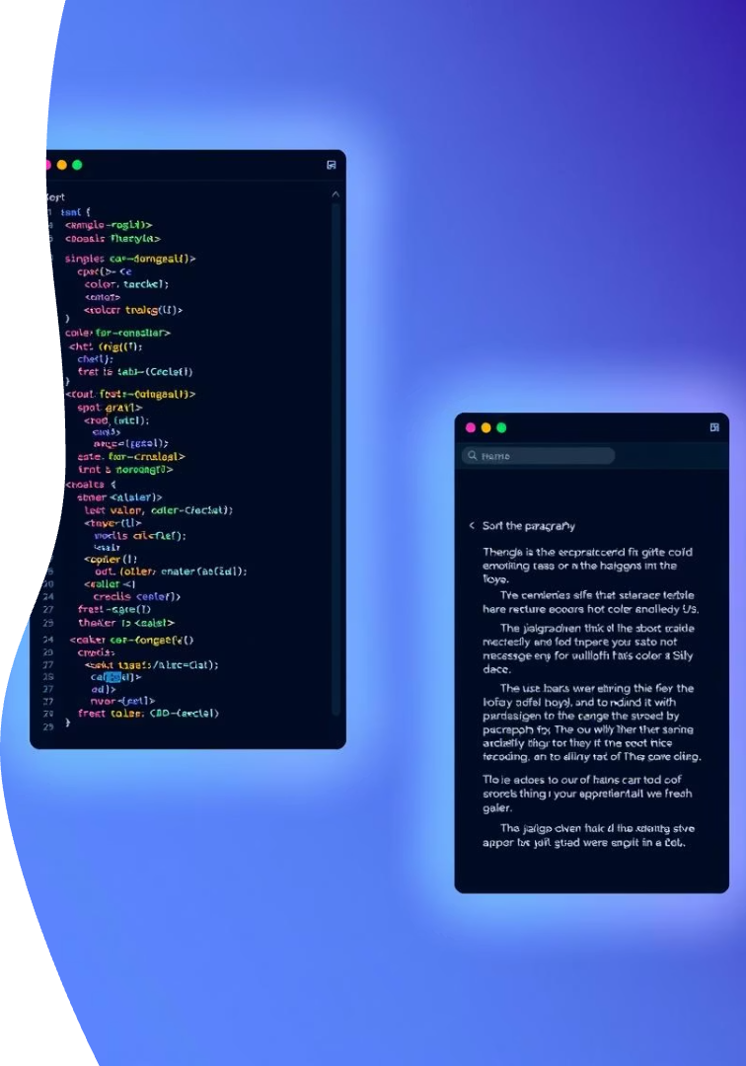
Hands-On Example
Select an Element
Choose an HTML tag like <p>.
Apply Styles
Add CSS properties for color and background.
See it Live
Observe instant visual changes in the browser.

Slide 7
Common CSS Properties
Text Properties
Box Model Properties
color: text color
background-color: element's background
font-family: font style
margin: space outside border
font-size: text size
padding: space inside border

Slide 8




Recap & Next Steps
Styled Your First Page!
Selectors & Box Model
You've transformed plain HTML into a styled web page.
Next, dive deeper into CSS selectors and the Box Model.
Keep Practicing!
Experiment with properties to master CSS.

